Slide 1
What MATTERS At End-Of-Life?
Jeanne Chirico
Hospice and Palliative Care Association of NYS
For: HANYS
June 6, 2022

Slide 2
‘The US is the only country that thinks that death is optional’
Anne Wilkinson, Ph.D. Center to Improve Care of the Dying 1996

Slide 3
Lack of Advance Care Planning in COVID
Has there ever been a time in our history that people are more aware of their mortality?
Does this make us more open to education and conversations about Advance Care Planning?
Would decision of family to call 911 have been impacted?
If the Emergency Department provider had a valid advance care plan, would some of the COVID patients not been intubated or resuscitated ? Would care have been different?

Slide 4
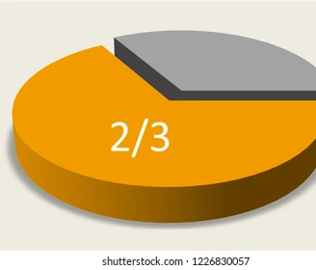
Two thirds of Americans don’t have a living will or advance directive outlining their wishes for end-of-life care.
Ninety percent of older Americans hope to stay in their own home as they age—yet one in four already has difficulty with everyday needs like bathing, dressing and getting around the house.

Slide 5
Conversations About Advance Care Planning
“A goal without a plan is just a wish.”
― Antoine de Saint-Exupéry

Slide 6
Curative/Aggressive Treatment
Palliative Care
Hospice Care

Slide 7
Individual
Curative Tx
Clinical Trials
Disease Focus
Family
Q-O-L Focus
Comfort Care
At Home Care

Slide 8
What Lies In The Gap
Lack of patient choice--
Social Determinants go unaddressed adding to frequent re-hospitalizations
Poor Coordination of Care
Poor Quality of Life
High-Cost End-of-Life Care

Slide 9
A recent consensus statement defined ACP as “a process that supports adults at any age or stage of health in understanding and sharing their personal values, life goals, and preferences regarding future medical care,” with the goal of helping to “ensure that people receive medical care that is consistent with their values, goals, and preferences during serious and chronic illness.”⁻⁻⁻American Medical Association
Bridging The Gap

Slide 10
Why ACP Matters
We can’t plan for everything, but we can help others share what matters to them with the people who matter to them
We can help those around us make sure they get the kind of healthcare that’s right for them through the end of life
We can assist individuals we work with to talk about what’s on their mind and in their hearts related to their future even when it’s scary and uncomfortable

Slide 11
Why Advance Care Planning “Matters”
Invite
Invite people into conversations within safe, comfortable, familiar environment
Guide
Guide people through the ACP process with supportive and knowledgeable facilitators
Help
Help individuals reflect on their values and beliefs as a guide to healthcare decision-making
Refer
Refer to appropriate medical, religious, legal or communal resources
Emphasize
Emphasize the importance of designating and communicating one’s wishes to a healthcare agent
Complete
Complete an advance directive / Health Care Proxy form
Encourage
Encourage communication with loved ones, clergy, physicians, attorneys
Build
Build community within and across patients, families, providers, and care team
Create
Create culture change – destigmatizing and normalizing end of life conversation

Slide 12
Who Has and AD?
12% of those age 18- 34
51% of those over 65
17% of those who are African American and Latino
31% of those who are white
21% of those with income under $25K
32% of those with incomes over $75K
14% of those who have not completed high school
38% of those with post graduate degrees

Slide 13
Decedents residing in Low Health Literacy areas, compared to those in High Health Literacy areas, had 31% higher odds of aggressive EOL care
“Associations Between Health Literacy and End-of-Life Care Intensity Among Medicare Beneficiaries”, Qingying Luo, MPH, Kewei Shi, MPH, Peiyin Hung, PhD, Shi-Yi Wang, MD, PhDFirst Published January 21, 2021

Slide 14
Consumer Resistance
Lack of understanding
Think you need a lawyer, and it is expensive
Hard to understand your own health conditions
Need for witnesses
A ‘death is optional’ attitude
Lack of trust
Cultural and language barriers

Slide 15
End-of-life conversations and related clinical outcomes
1 No change in depression or anxiety | 2 Earlier hospice enrollment (66% vs. 45%) | 3 Lower rate of CPR (0.8% vs. 6.7%) | 4 Longer hospice with better quality of life (6.9 vs. 5.6)
5 Lower rate of ventilation (1.6% vs. 11%) | 6 Less aggressive care = better quality of life (6.4 vs. 4.6) | 7 ICU admission (4.1% vs. 12.4%) | 8 Better quality of life with improved caregiver outcomes
Wright, AA et al, “Association between end-of-life discussions, patient mental health, medical care near death, and caregiver bereavement adjustment, JAMA. 2008;300(14): 1665‒1673.

Slide 16
Outcome of ACP
Documented benefits of ACP include improvements
in patient and family satisfaction and wellbeing,
improved concordance between preferences for care and delivered care,
health care savings.
Gift to family/ proxy to be able to honor your wishes instead of being burdened with making a life altering health care decision
A means of taking control – self determination throughout the course of your lifetime

Slide 17
Advance Care Planning
Advance Directives
ACP is an ongoing process to discuss current situation and desired interventions/outcomes.
ACP is a conversation among the individual, their family, and the healthcare professionals on their team
ACP is educational as the individual learns about care options and consequences of treatment as well as hospice and palliative care education
Advance Directives are documents that identify your wishes and in NY they include:
HCP
Power of Attorney Financial/durable
MOLST

Slide 18
What makes an effective approach?
Shift the focus of end-of-life decision making away from document completion and toward facilitating discussion of values and preferences.
Do not stress importance of making choices about every possible intervention
Provide guidelines for how to make decisions

Slide 19
Start the conversation
Many people wait until a crisis occurs before they talk about their values and preferences, wishes for health care or details of their finances. If you wait until a fall, accident or serious diagnosis, big decisions may be driven by assumptions.

Slide 20
Look for an opening
A lot of uncertainty can be avoided if you talk with people before something happens.
It’s easy to put off these conversations because they can be difficult, and they take time.
It never seems like the right time to bring up what may be an uncomfortable topic, yet you may be surprised to find the person has been waiting for someone to talk to.
“I would like to talk about how you would like to be cared for if you got really sick. Is that okay?”
“If you ever got really sick it would be important for us to know the kind of care you would like. Could we talk about this now?”

Slide 21
Conversations About Advance Care Planning
What would you want?
Assume you would be kept comfortable, no matter what treatments you would want or not want.
Would you want life sustaining treatments to continue?
Would you prefer care focused on keeping you comfortable without using medical interventions to keep you alive?

Slide 22
Advance Care Planning Best Practices
Useful questions in care planning process:
What experiences have you had with family or friends who became seriously ill or injured? What have you learned from those experiences?
Exploring meaning – asking about personal meaning of words and phrases (i.e. “I don’t want to be a vegetable,” “I want to die with dignity”.)
Reveals fears and concerns
Can offer opportunities for education and clarification of options
What activities, experiences and beliefs bring your life meaning and allow you to live well?
Clarify what specifically constitutes a good quality of life for this person
Explore religious, cultural or personal beliefs
Helps healthcare agents with future decision making

Slide 23
Advance Care Planning Best Practices
What is your understanding about your health condition?
Identify misunderstandings or gaps in knowledge
Create list of questions for doctor
Crucial for informed consent
What are your goals if your health worsens?
Specific to the person’s condition
Can change over time
What trade-offs are you willing to make to meet these goals?
Helps manage expectations
Reveals priorities
Going through these questions thoroughly and thoughtfully may require multiple conversations.

Slide 24
Conversations About Advance Care Planning
Explore religious, cultural or personal beliefs
What helps you when you face serious challenges in your life?
Do you have beliefs that might influence your preferences for using life-sustaining treatment interventions?
Do you need to discuss these beliefs or clarify any concerns with others?

Slide 25
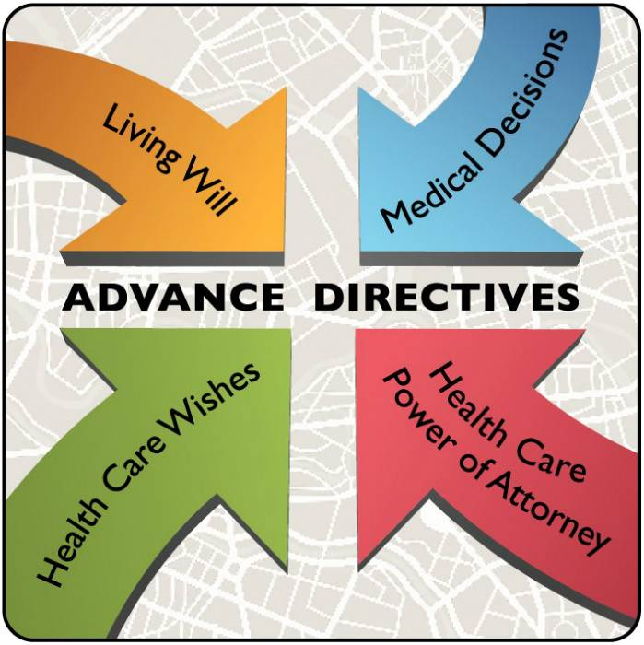
Different Forms
A Health Care Proxy lets you appoint
a Healthcare Agent -- that is, someone you trust to make health care decisions for you if you are unable to make decisions for yourself.
A Living Will allows you to leave written instructions that explain your health care wishes, especially about end-of-life care. You cannot use a Living Will to name a health care agent- nor is it legally binding

Slide 26
Health Care Proxy Considerations
Things to think about when choosing a health care agent (decision-maker)
Responsibilities of a health care agent include – making choices about medical care, reviewing and releasing medical records, arranging for medical care and treatment, making decisions on living situation, deciding which providers can provide treatment
Consider
Choosing a person who can make difficult decisions under pressure or in emotional situations.
Choosing a person who understands your preferences, values and goals
Choosing a person you know and trust to follow your preferences, even if they are different from their own

Slide 27
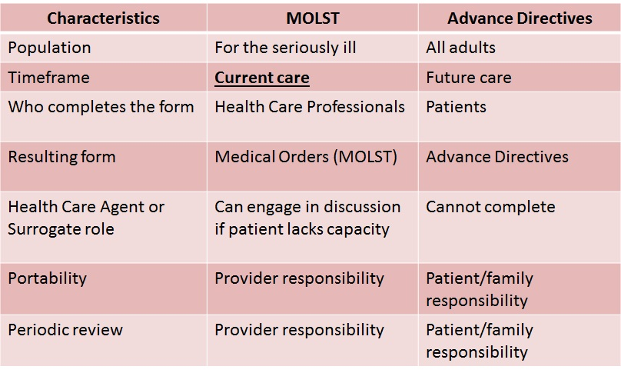
NYS Advance Directives vs. MOLST

Slide 28
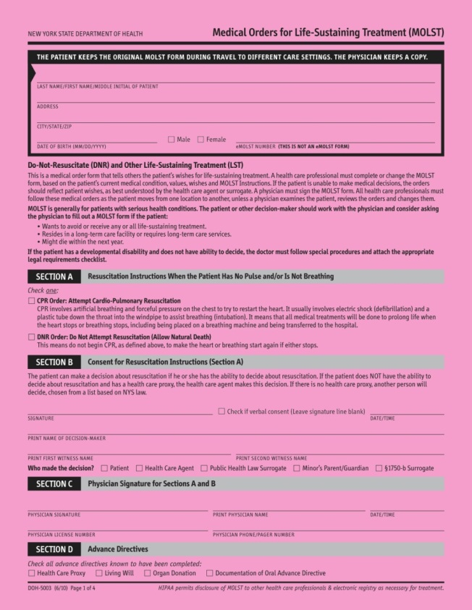
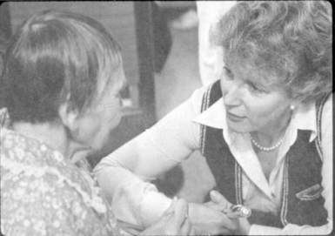
eMOLST Produces MOLST Form and MOLST Chart Documentation Form
Align with NYSDOH Checklists

Slide 29
Frequent Healthcare Provider Issues With ACP
Discomfort in having the conversation
Only required to ask if they have one
Receptionist asks the question- in the lobby
Lack of time for providers
Who is ‘in charge’ of the patient- not wanting to step on another doctors turf- ex: hospitalist and specialists think the PCP did it- the PCP has not seen the patient in a year
Prognostication issues- 73% overly optimistic
Challenges to accessing the documents when needed
Study by GAO April 2015

Slide 30
Doctors are people too. Sometimes it is difficult for them to accept that they can do no more, so they may want to accentuate the positive, however uncertain it may be. That may be exactly what some patients, caregivers, and inner circles want. Others may prefer that communications be more direct and balanced so that both possibilities but also probabilities are presented.

Slide 31
Working with Medical Providers
Encourage writing down thoughts and questions prior to visit.
What is bothering you most?
What do you hope to learn or understand?
What are the side effects of recommended drugs or treatments?
How will you know that you are getting better, that the treatment is working? How long should you expect that will take?
One useful approach is to ask something like, “Would you be surprised if (name) died in the next year/six months?” By framing the question of life expectancy differently, the question becomes easier to answer.

Slide 32
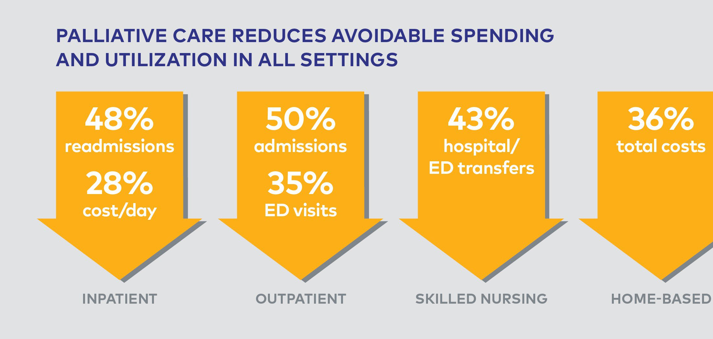
Why Palliative Care Services Are Good For All
Pain and Symptom management Leading to improved quality and decreased cost
Prognostication aiding in earlier hospice referrals
Advance care planning aligning goals of care and treatment received
Educate patients on their disease process as a routine part of care
Spiritual and psychosocial support for patient and loved ones
Assist with community resources and Social Determinants of Care
Coordination of Care Including Primary Care Involvement Throughout
Help patients navigate the healthcare system Including Communication with Insurance Case Managers as Warranted

Slide 33
Benefits of Medicare Hospice
Care is provided in almost all settings (including SNF, shelters, relative’s homes)
Cost savings to family with decreased out-of-pocket expense
High Satisfaction Rate
Improved Quality of Life for patient and caregivers
Health Care Cost Savings with decreased inpatient expense
Ongoing support to bereaved family
Notes:
Great comprehensive, capitated benefit so it must be widely utilized…

Slide 34
QUESTIONS
JCHIRICO@HPCANYS.ORG

Slide 35
ADDITIONAL RESOURCES
Advance Directives: Making Your Wishes Known, NY State Office of the AG: https://ag.ny.gov/sites/default/files/advancedirectives.pdf
GAO February 2019 Advance Care Planning, Selected States Efforts to Educate and Address Access Challenges: https://www.gao.gov/assets/700/696985.pdf
US Catholic Bishops: ethical-religious-directives-
https://www.usccb.org/resources/ethical-and-religious-directives-catholic-healthcare-services

